Slide 1

Object Oriented Programming in Python

Slide 2
What is Object Oriented Programming(OOP)?
A programming paradigm which provides a means of structuring programs so that properties and behaviors are bundled into individual objects.
It allows us to think of the data in our program in terms of real-world objects, with both properties and behaviors.
Properties define the state of the object. This is the data that the object stores.
Behaviors are the actions our object can take. Oftentimes, this involves using or modifying the properties of our object.

Slide 3
Classes
A class is a blueprint for the object
It is a user-defined prototype for an object that defines a set of attributes that characterize any object of the class.

Slide 4
Classes: Creating Classes
Start with the class keyword to indicate that you are creating a class
The keyword is followed by the name of the class.
According to the PEP 8 style guide, class names should normally use the CapWords convention I.e., CamelCase notation.
Note: When using acronyms in CapWords, capitalize all the letters of the acronym. Thus HTTPServerError is better than HttpServerError.

Slide 5
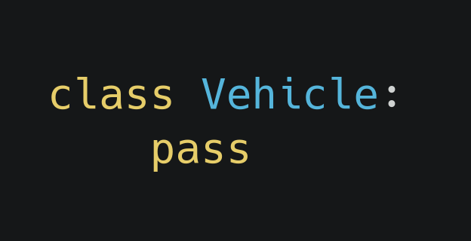
Classes: Creating Classes
We have used keyword class to indicate that we are creating a class.
We have used keyword pass in the place where the code will eventually go
This creates a class named Vehicle, this process is called class definition

Slide 6
Objects
An object (instance) is an instantiation of a class.
Class definition defines the description for the object and hence no memory or storage is allocated
Once we have our class, we can instantiate it to create a new object from that class.
The created object has the type of the class it was instantiated from.

Slide 7
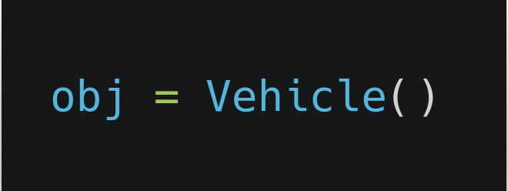
Instantiating classes: (creating objects)
Here, obj is an object of class Vehicle

Slide 8
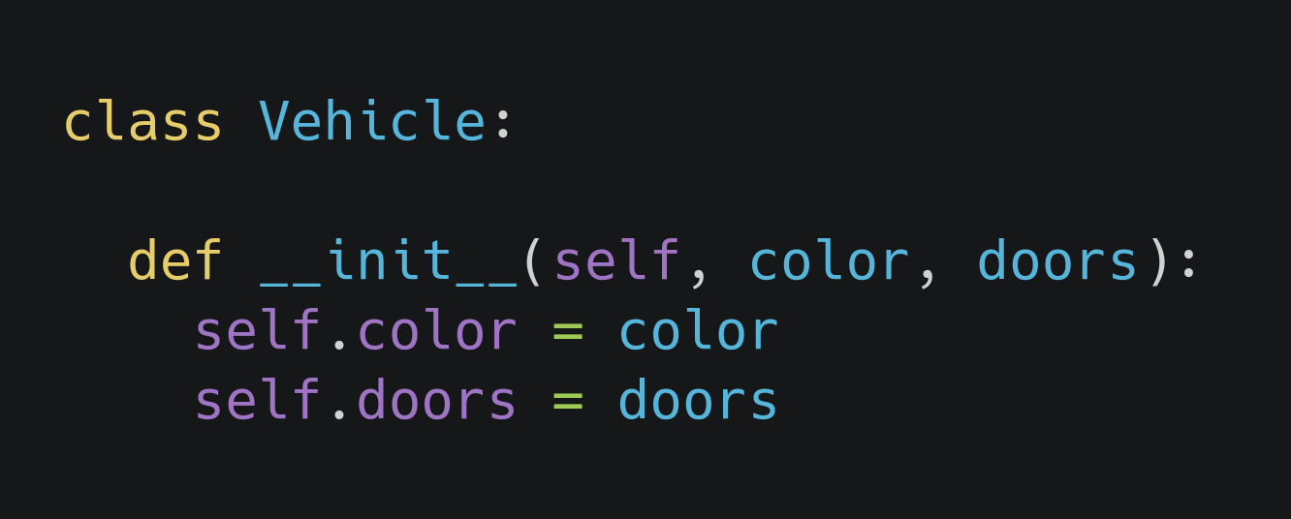
Class and Instance Attributes
Classes contain characteristics called Attributes: instance attributes and class attributes.
Instance attribute: Instance Attributes are unique to each object, (an instance is another name for an object).
Here, any Vehicle object we create will be able to store its color and doors. We can change either attribute of either vehicle object, without affecting any other objects we’ve created.

Slide 9
Class and Instance Attributes
__init__(): __init__ is called the initializer.
It is automatically called when we instantiate the class.
Its job is to make sure the class has any attributes it needs.
It also makes sure that the object is in a valid state when it’s instantiated, it'd be invalid if user try instantiating an object using negative value for doors attribute, wouldn't it?

Slide 10
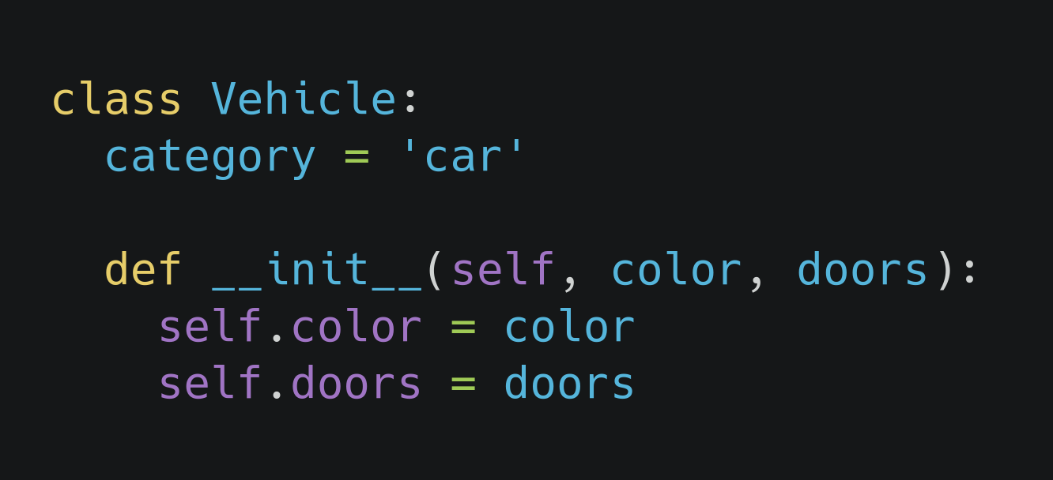
Class and Instance Attributes
Class attributes:
Class Attributes are unique to each class.
Each instance of the class will have this attribute.
Here, category is a class attribute.

Slide 11
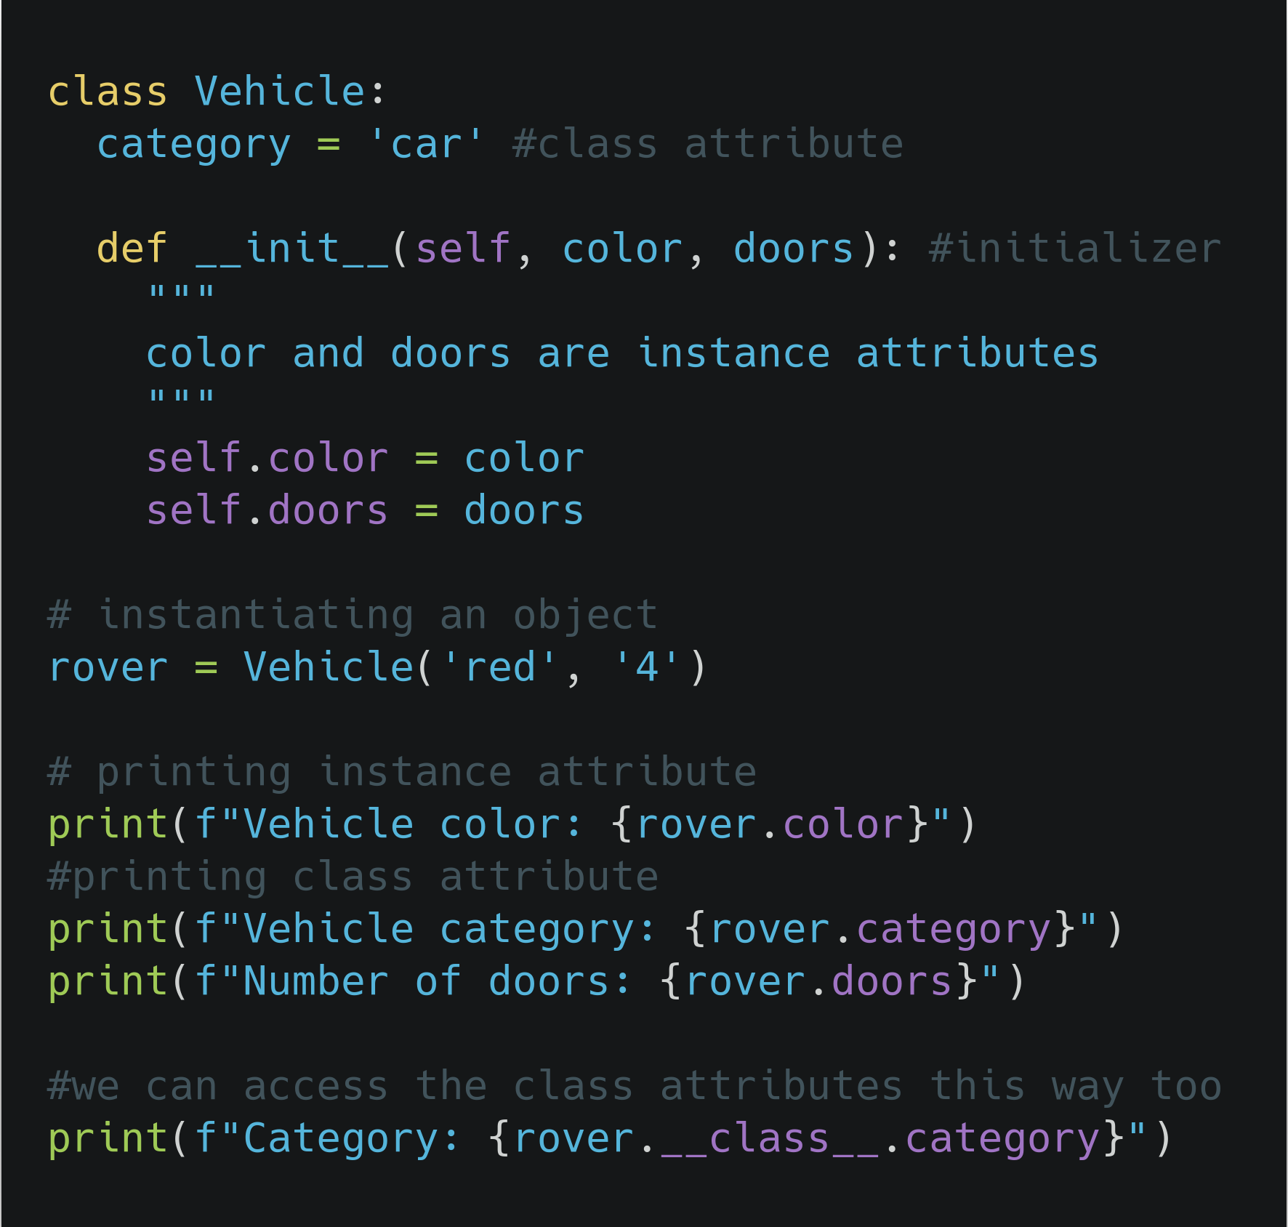
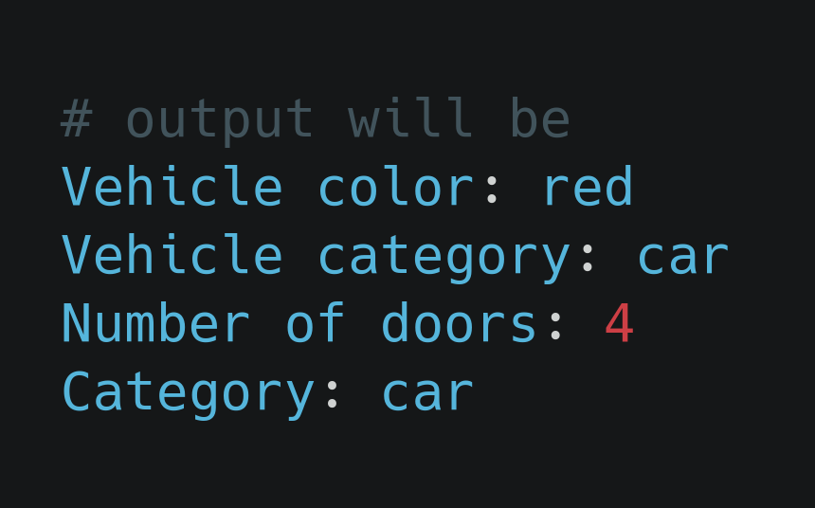
Class and Instance Attributes: (Example)

Slide 12
Methods:
Functions defined inside the body of a class.
They are used to define the behaviors of an object.
Just like functions, methods can accept parameters, and they can access the attributes of the object they belong to.
Let's add a method description() in our class Vehicle and try accessing the method in the next slide.

Slide 13
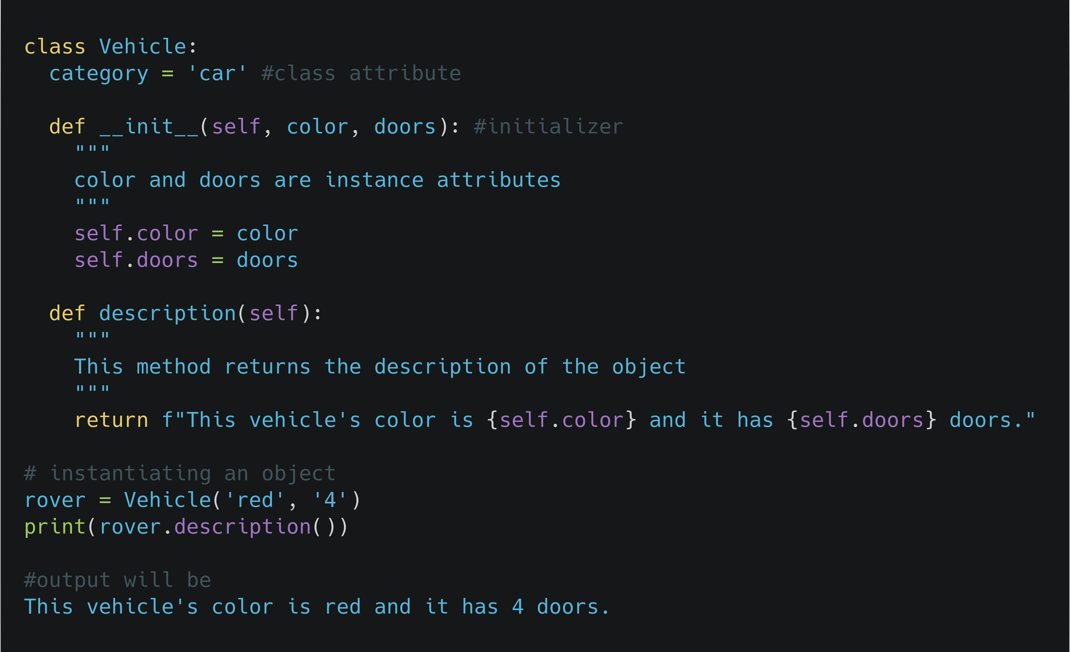
Methods:(example)

Slide 14
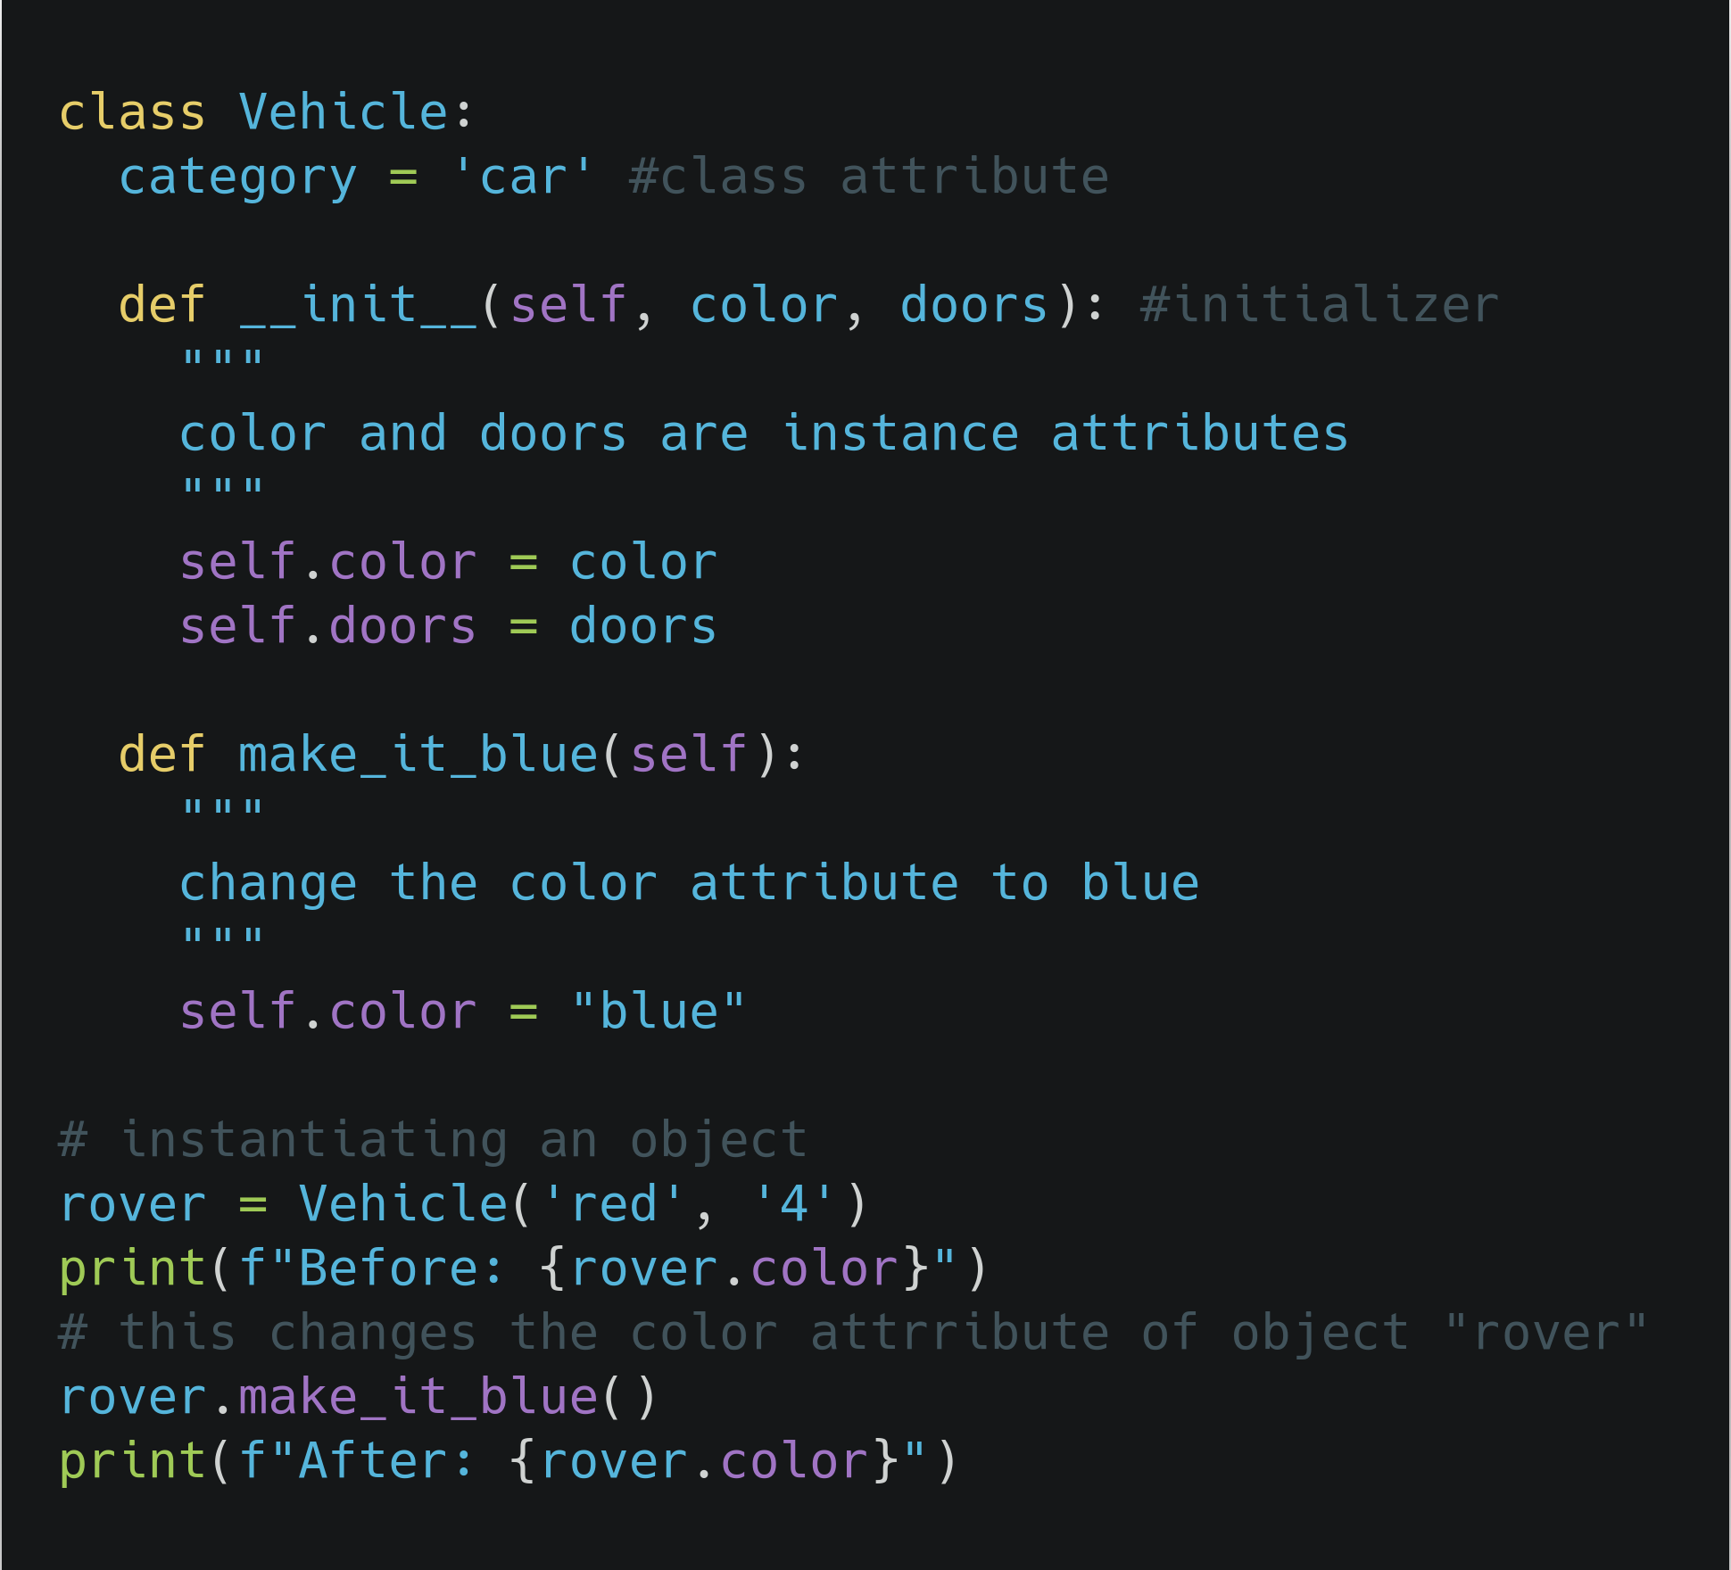
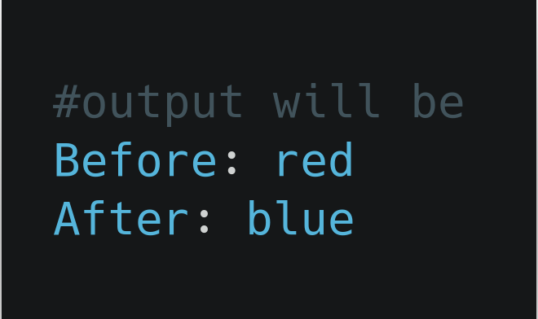
Methods: Modifying Attributes
make_it_blue() modifies the color attribute of the instance.
It changes the attribute to "blue".
We can see the before and after value of the attribute color of object rover.

Slide 15
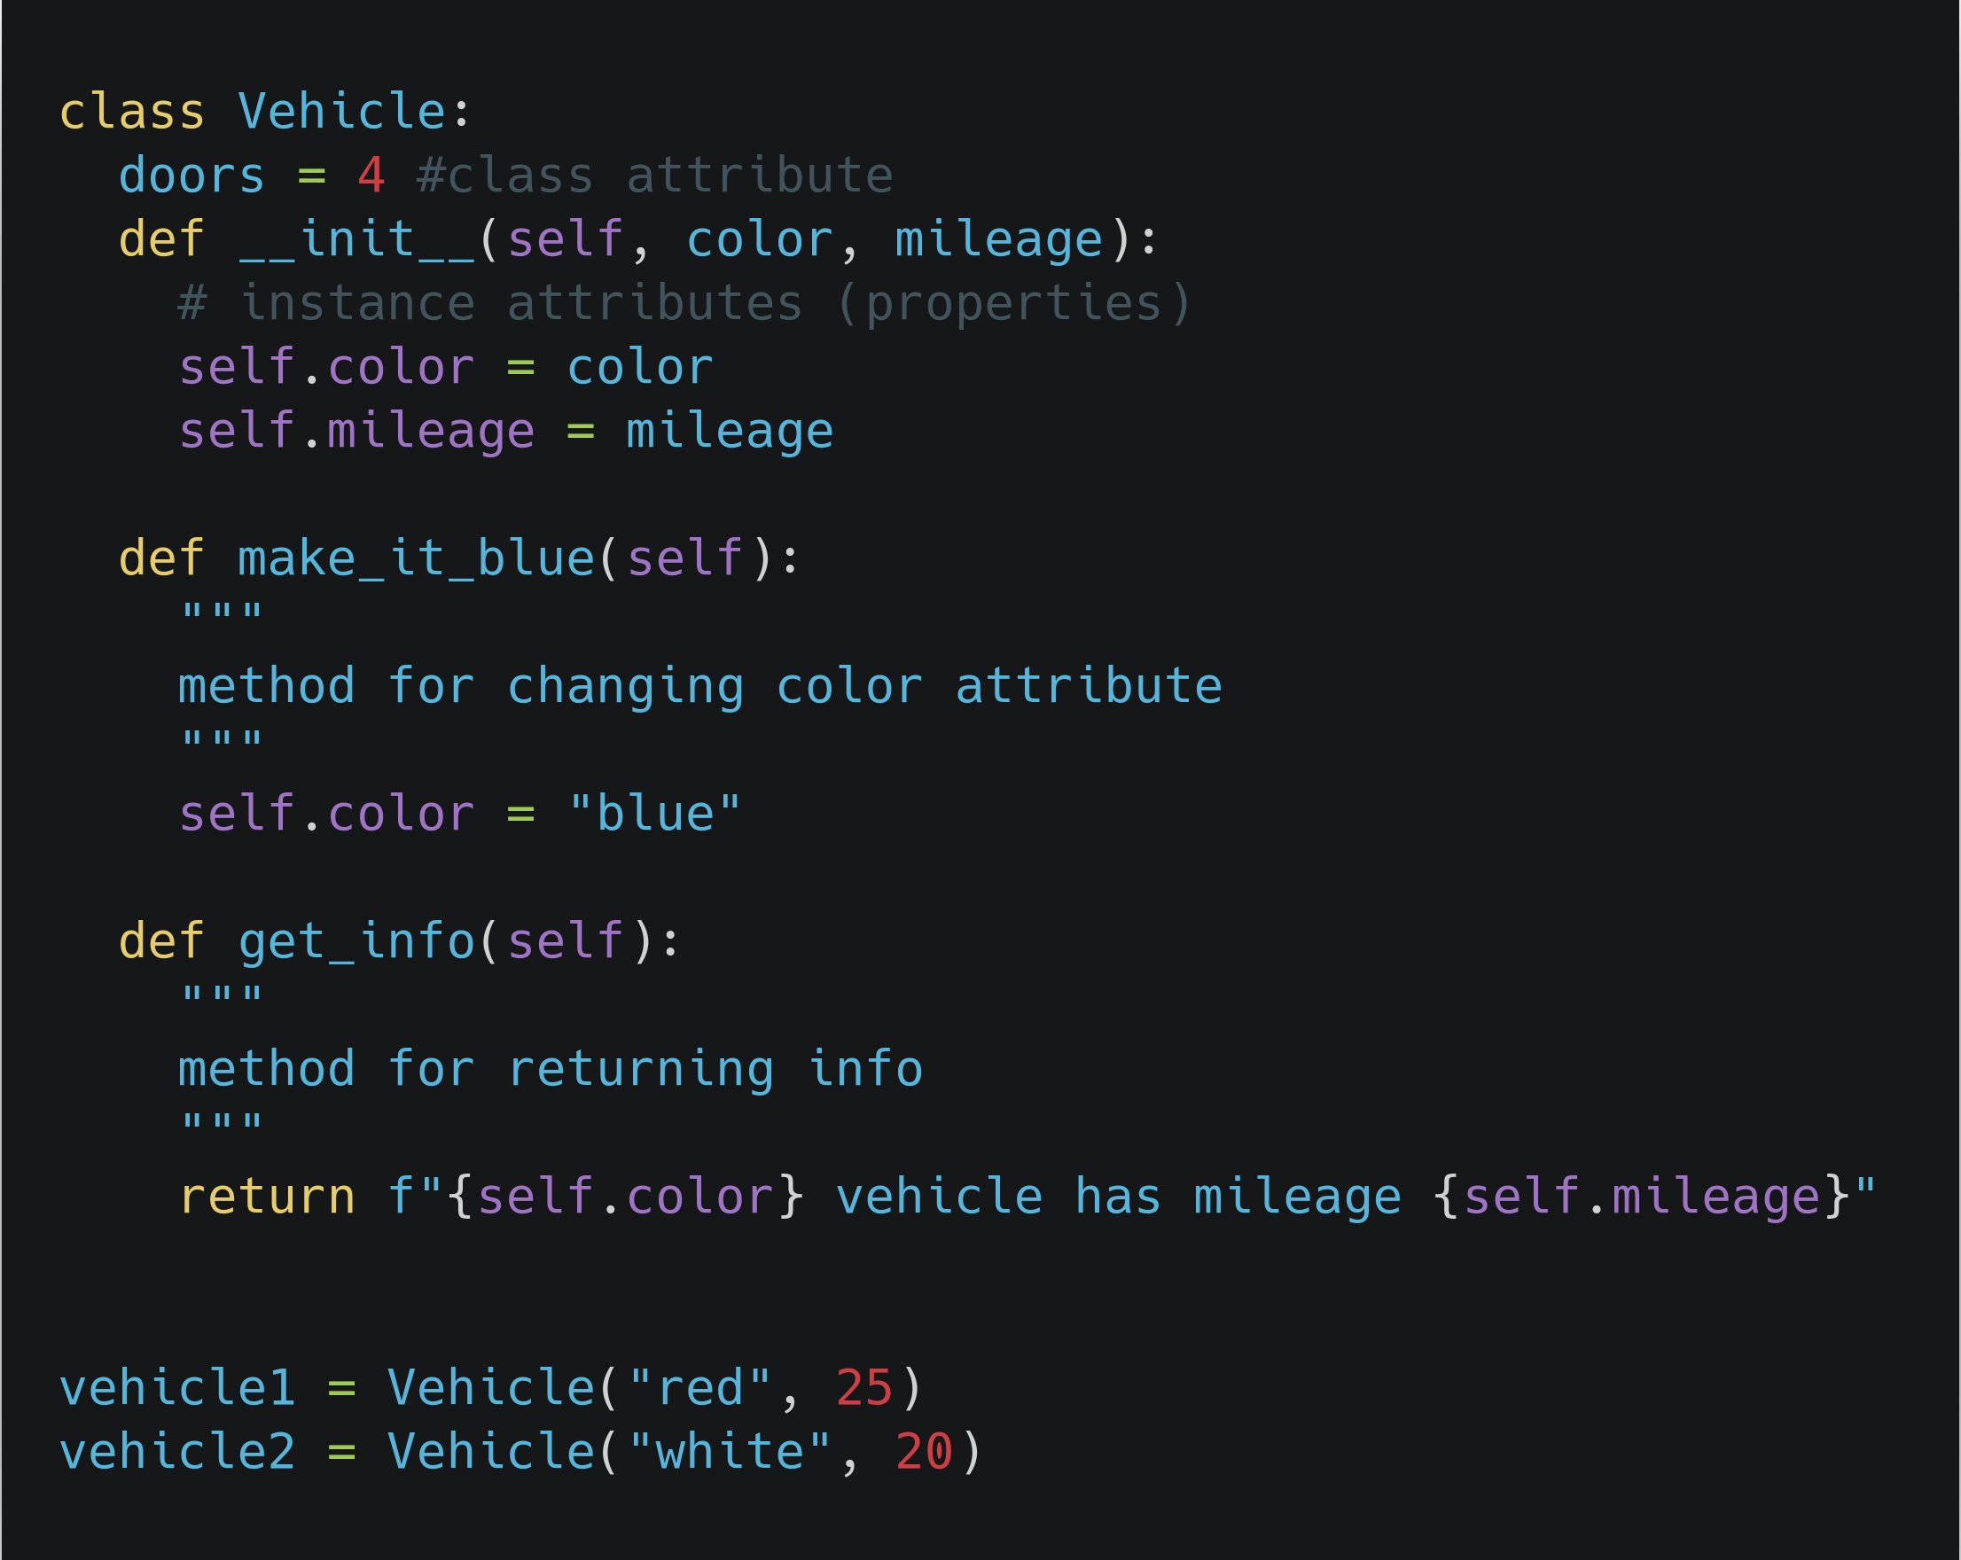
Putting it all together: (example)
Here, we have a class Vehicle, with class attribute doors and instance attribute color and mileage
make_it_blue() is a method that modifies the color attribute of instance
get_info() method returns a string with format as shown in the code
vehicle1 and vehicle2 are objects we have instantiated

Slide 16
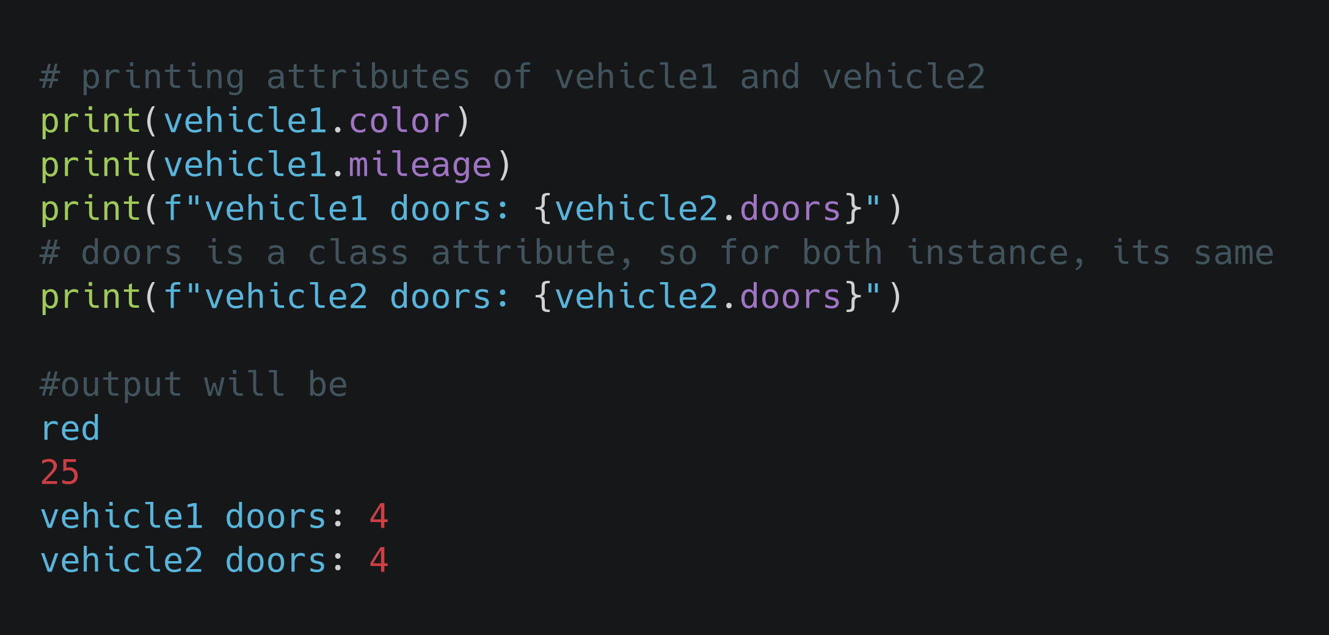
Putting it all together: (example)

Slide 17
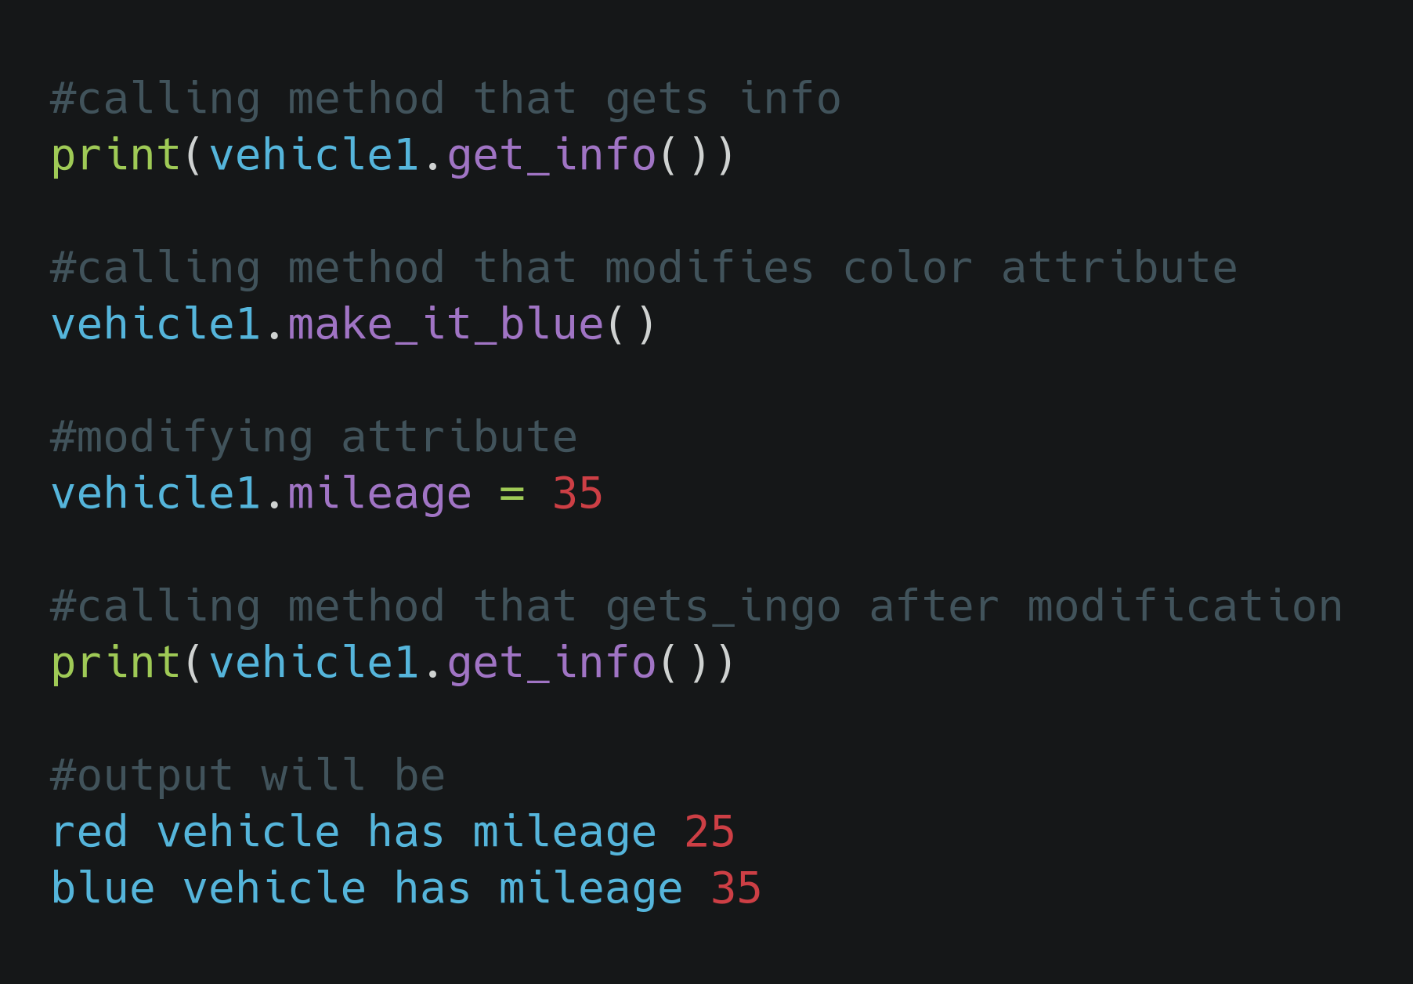
Putting it all together: (example)

Slide 18
Inheritance

Slide 19
Inheritance
Inheritance is the process by which one class takes on the attributes and methods of another.
Newly created classes are called child classes or derived classes.
The classes that child classes are derived from are called parent classes or base classes
Child classes contain the details of the parent class they're derived form

Slide 20
Type of Inheritance
Single Inheritance
Multiple Inheritance
Multilevel Inheritance
Hierarchical Inheritance
Hybrid Inheritance

Slide 21
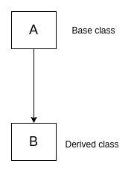
Single Inheritance
Single inheritance enables a derived class to inherit properties from a single parent class
Thus enabling code reusability and addition of new features to existing code.
Fig: Single Inheritance

Slide 22
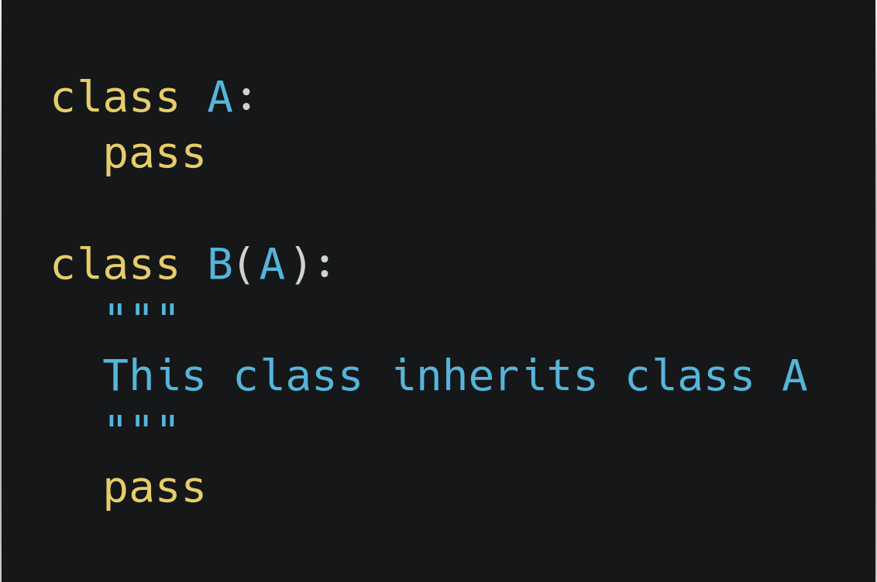
Single Inheritance
We have two classes, class A and class B.
Here, class A is the base class for class B as class B inherits class A.
Objects of class B will have all the details of class A

Slide 23
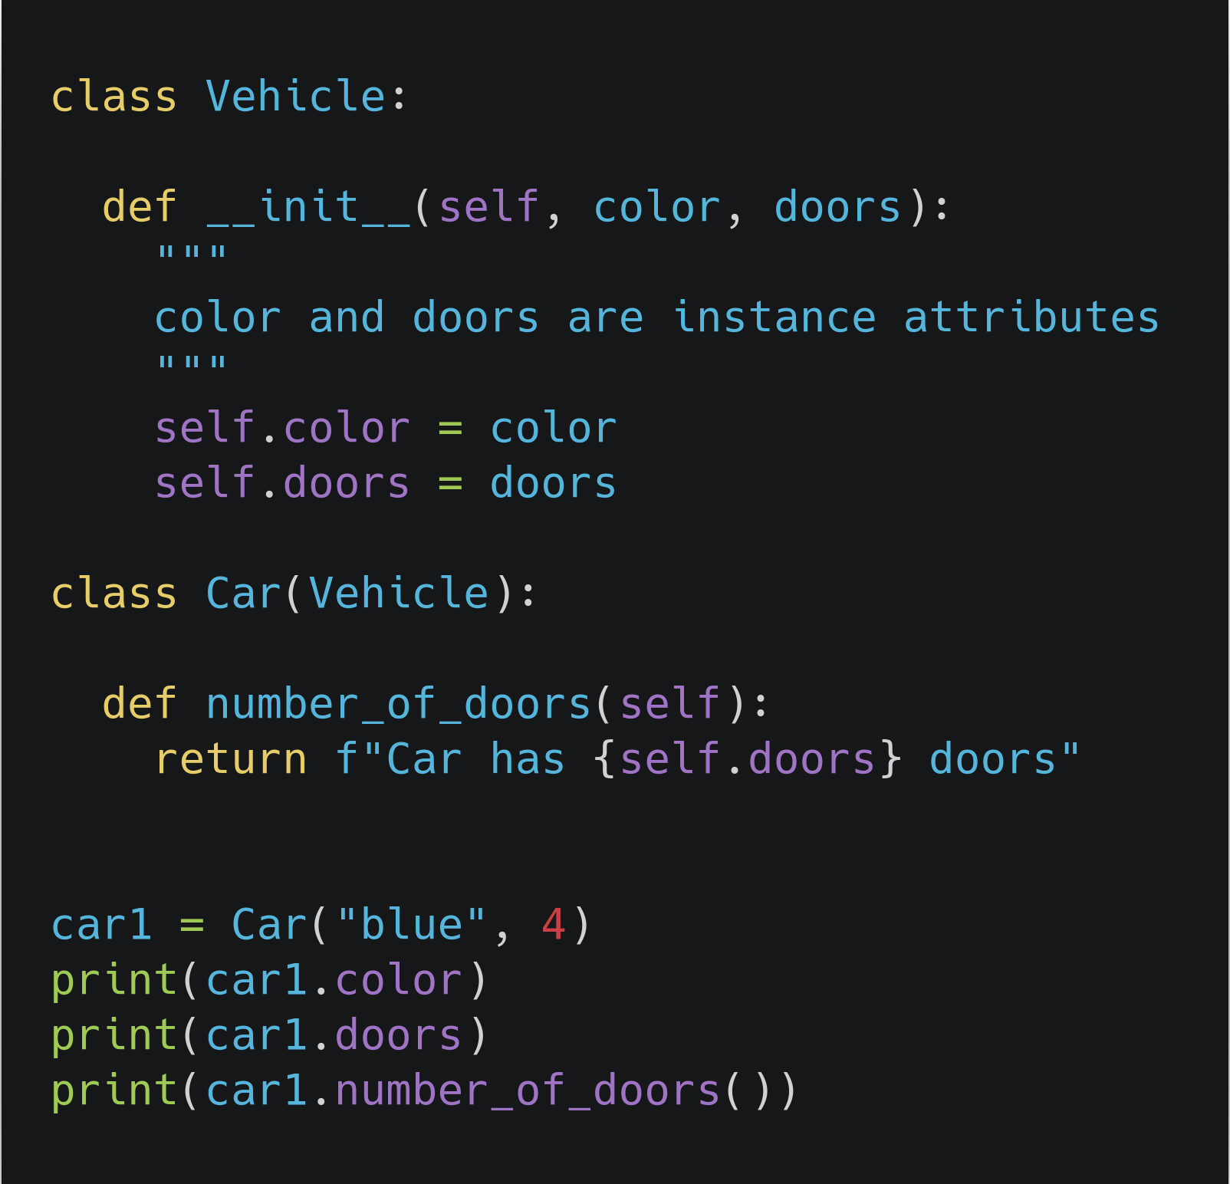
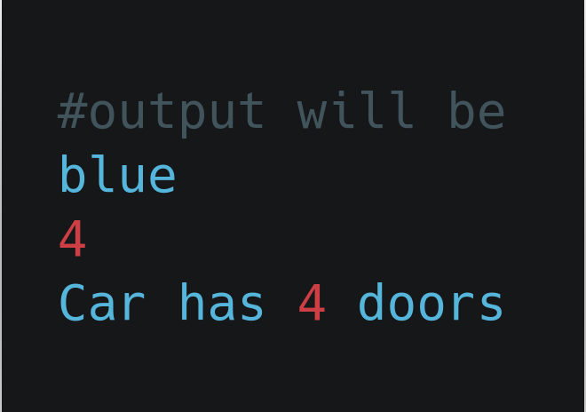
Example:
Here, class Car is derived from base class Vehicle.
An object is instantiated and assigned to variable car1.
As we see, object car1 has the same attributes as the base class.
Moreover, we have added a method number_of_doors().

Slide 24
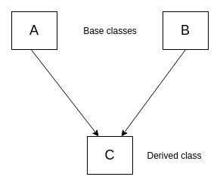
Multiple Inheritance
When a class is derived from more than one base classes this type of inheritance is called multiple inheritance.
In multiple inheritance, all the details of the base classes are inherited into the derived class.
fig: multiple inheritance

Slide 25
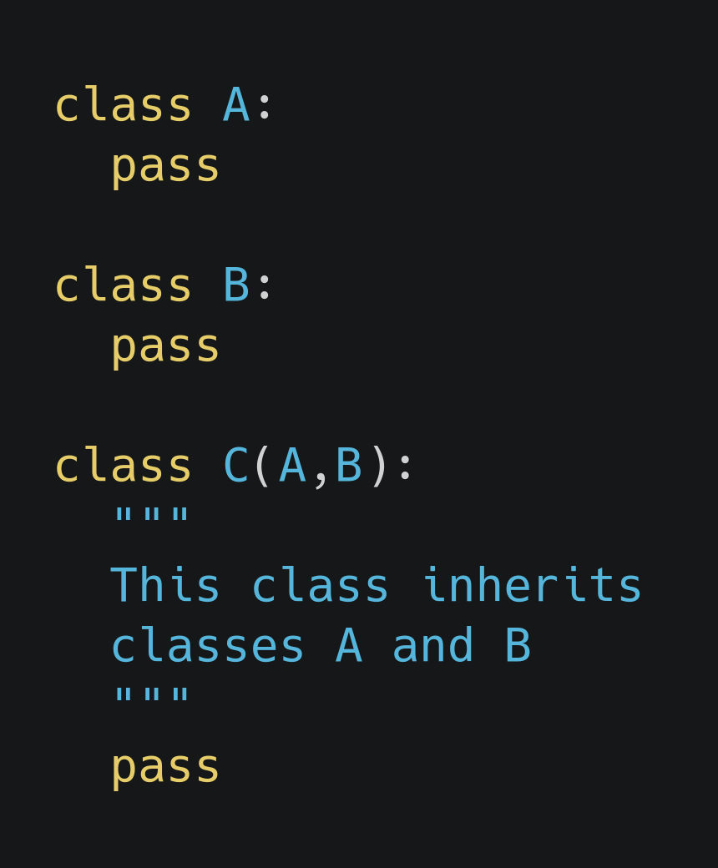
Multiple Inheritance
We have three classes: class A, class B and class C
Here, class C is derived from class A and B
Since the class C inherits from multiple classes, the inheritance it follows is called multiple inheritance
Objects of class C will have all the details of class A and B.

Slide 26
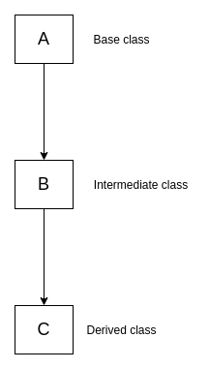
Multilevel Inheritance
In multilevel inheritance, features of the base class and the derived class are further inherited into the new derived class.
As shown in the figure, B is derived form A and C is derived from B
In this type of inheritance, a class can inherit from a child class/derived class. B is a child class of A and class C inherits it.
fig: multilevel inheritance

Slide 27
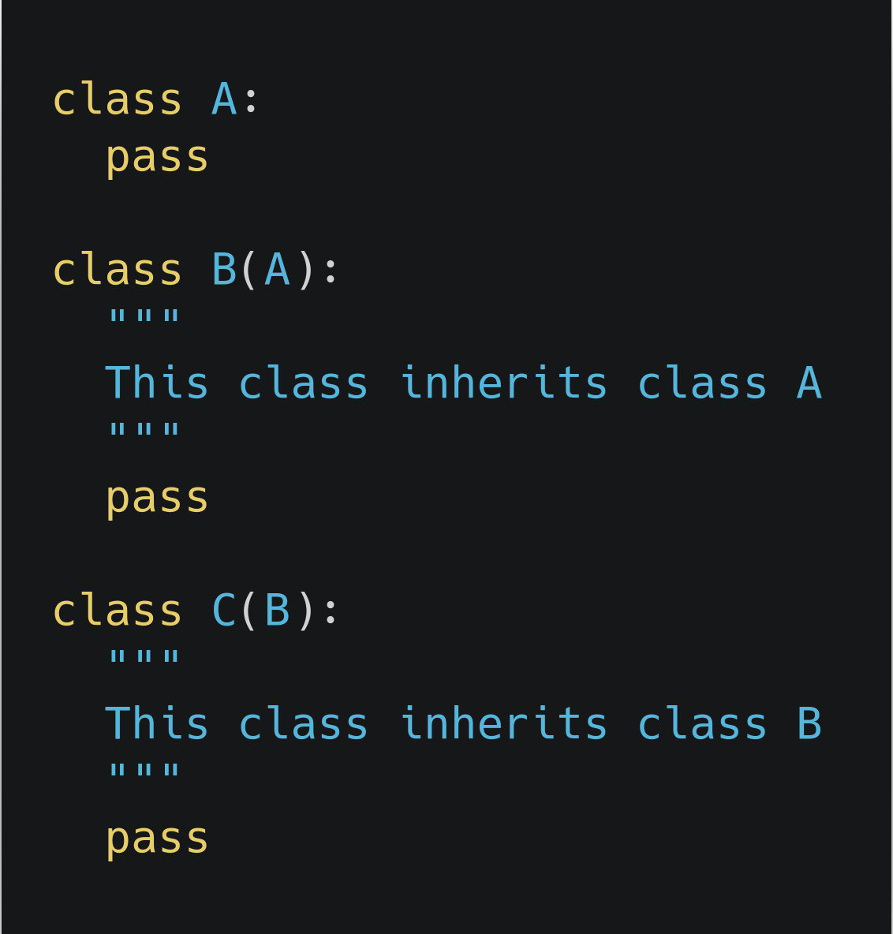
Multilevel Inheritance
We have three classes: class A, class B and class C
Class B inherits A, so class B has all the details of class A
Class C inherits class B, so class C has all details of B
Objects of class C will have all the details of class A and B.

Slide 28
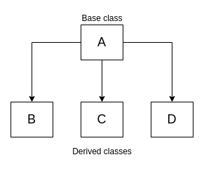
Hierarchical Inheritance
When more than one derived classes are created from a single base this type of inheritence is called hierarchical inheritance.
As shown in the figure, we have a parent class, class A and multiple classess B, C and D are derived from it.
fig: Hierarchical inheritance

Slide 29
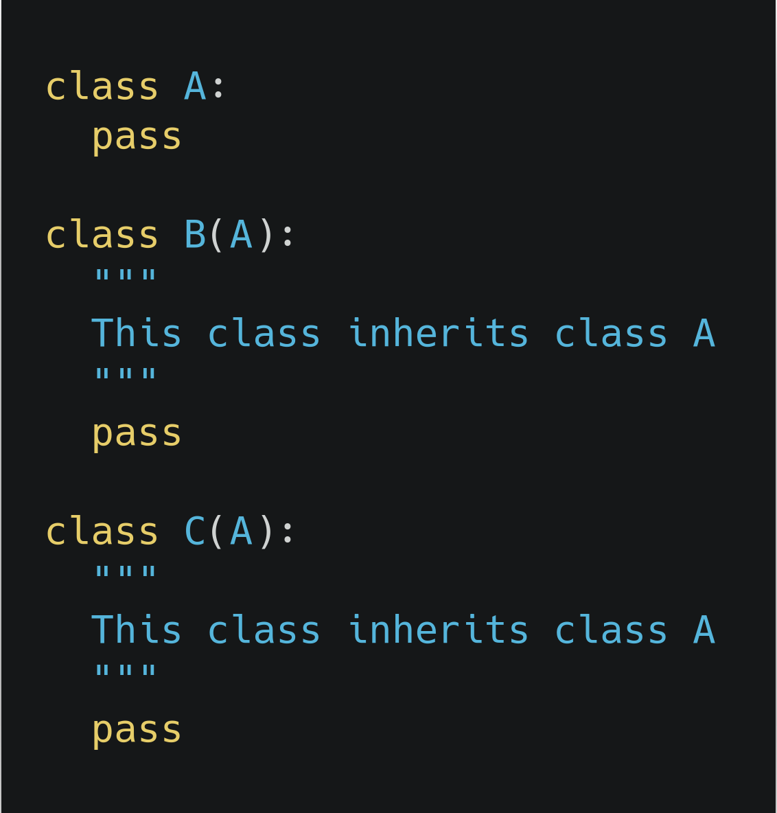
Hierarchical Inheritance
We have three classes: class A, class B and class C
Class B inherits A, so class B has all the details of class A
Class C alse inherits class A, so class C has all details of A
Base class A has been inherited multiple times, this kind of inheritance is called Hierarchical inheritance

Slide 30
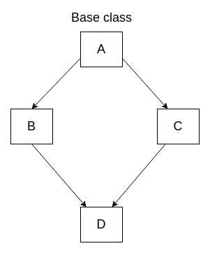
Hybrid Inheritance
Inheritence consisting of multiple types of inheritence is called hybrid inheritence.
This type of inheritance is the mixture of many inheritance types discussed in the previous slides.
fig: Hybrid inheritance

Slide 31
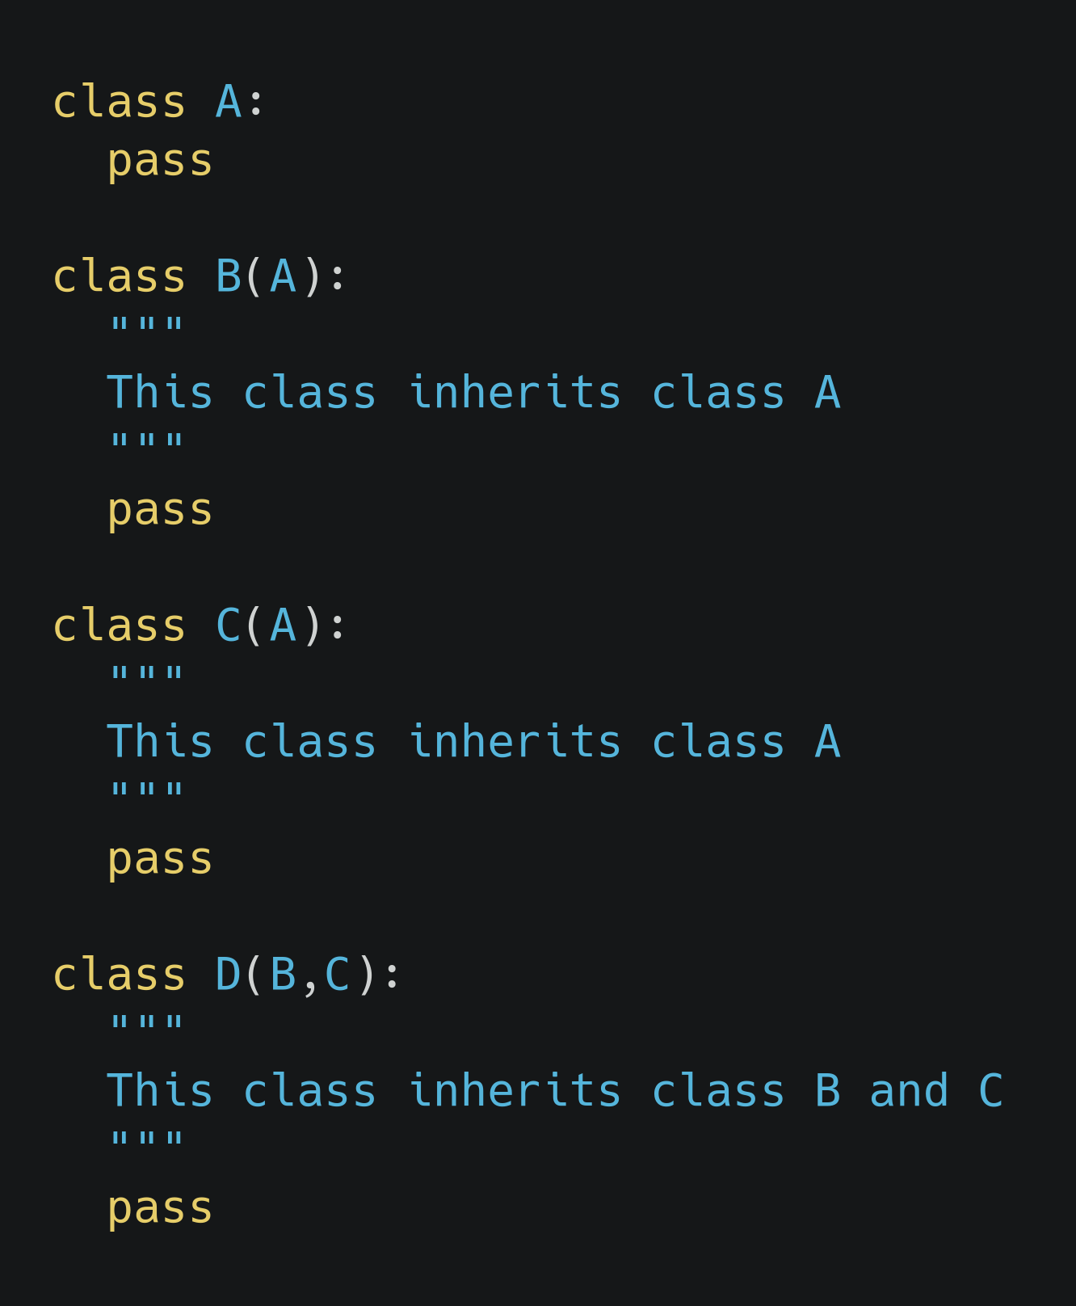
Hybrid Inheritance
We have four classes: class A, class B, class C and class D
As we see, there are multiple types of inheritance involved.

Slide 32
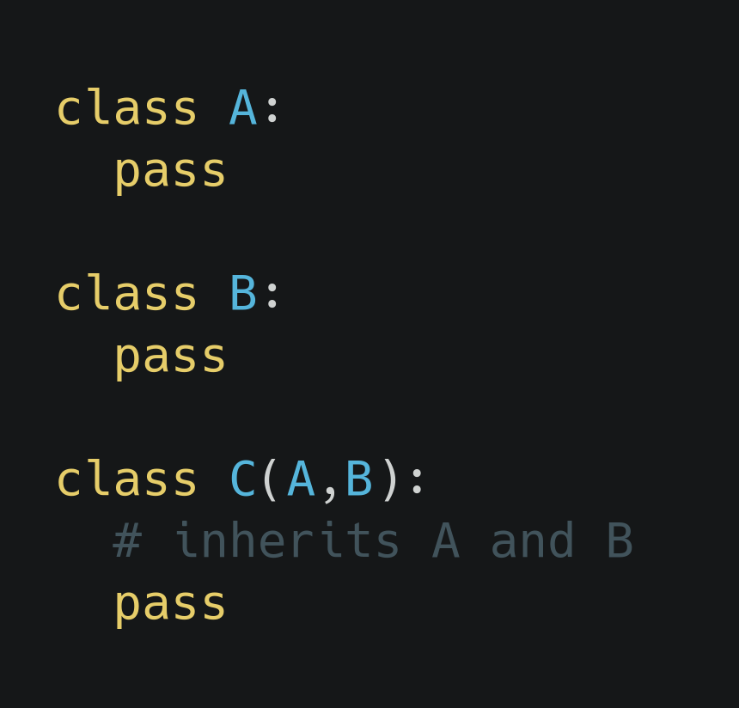
Order in which the attributes are searched in inherited class:
If we try to access an attribute in class D, it follows this order:
Attribute is searched in Inherited class: class C
Attribute is searched in base class: class A
Attribute is searched recursively in base classes of class A (if any)
Attribute is searched in base class: class B
Attribute is searched recursively in base classes of class B (if any)

Slide 33
Encapsulation
Encapsulation is one of the fundamental concepts in object-oriented programming (OOP).
It describes the idea of wrapping data and the methods that work on data within one unit.
This puts restrictions on accessing variables and methods directly and can prevent the accidental modification of data.
To prevent accidental change, an object’s variable can only be changed by an object’s method.
Those type of variables are known as private variable.

Slide 34
Protected members
Protected members are those data members of a class that can be accessed within the class and the classes derived from that class,
But unlike in Java or C++, protected members can be accessed in python.
All members in a Python class are public by default
Python's convention to make an instance variable protected is to add a prefix _ (single underscore) to it
By prefixing the name of your member with a single underscore, you’re telling others “don’t touch this, unless you’re a subclass”.

Slide 35
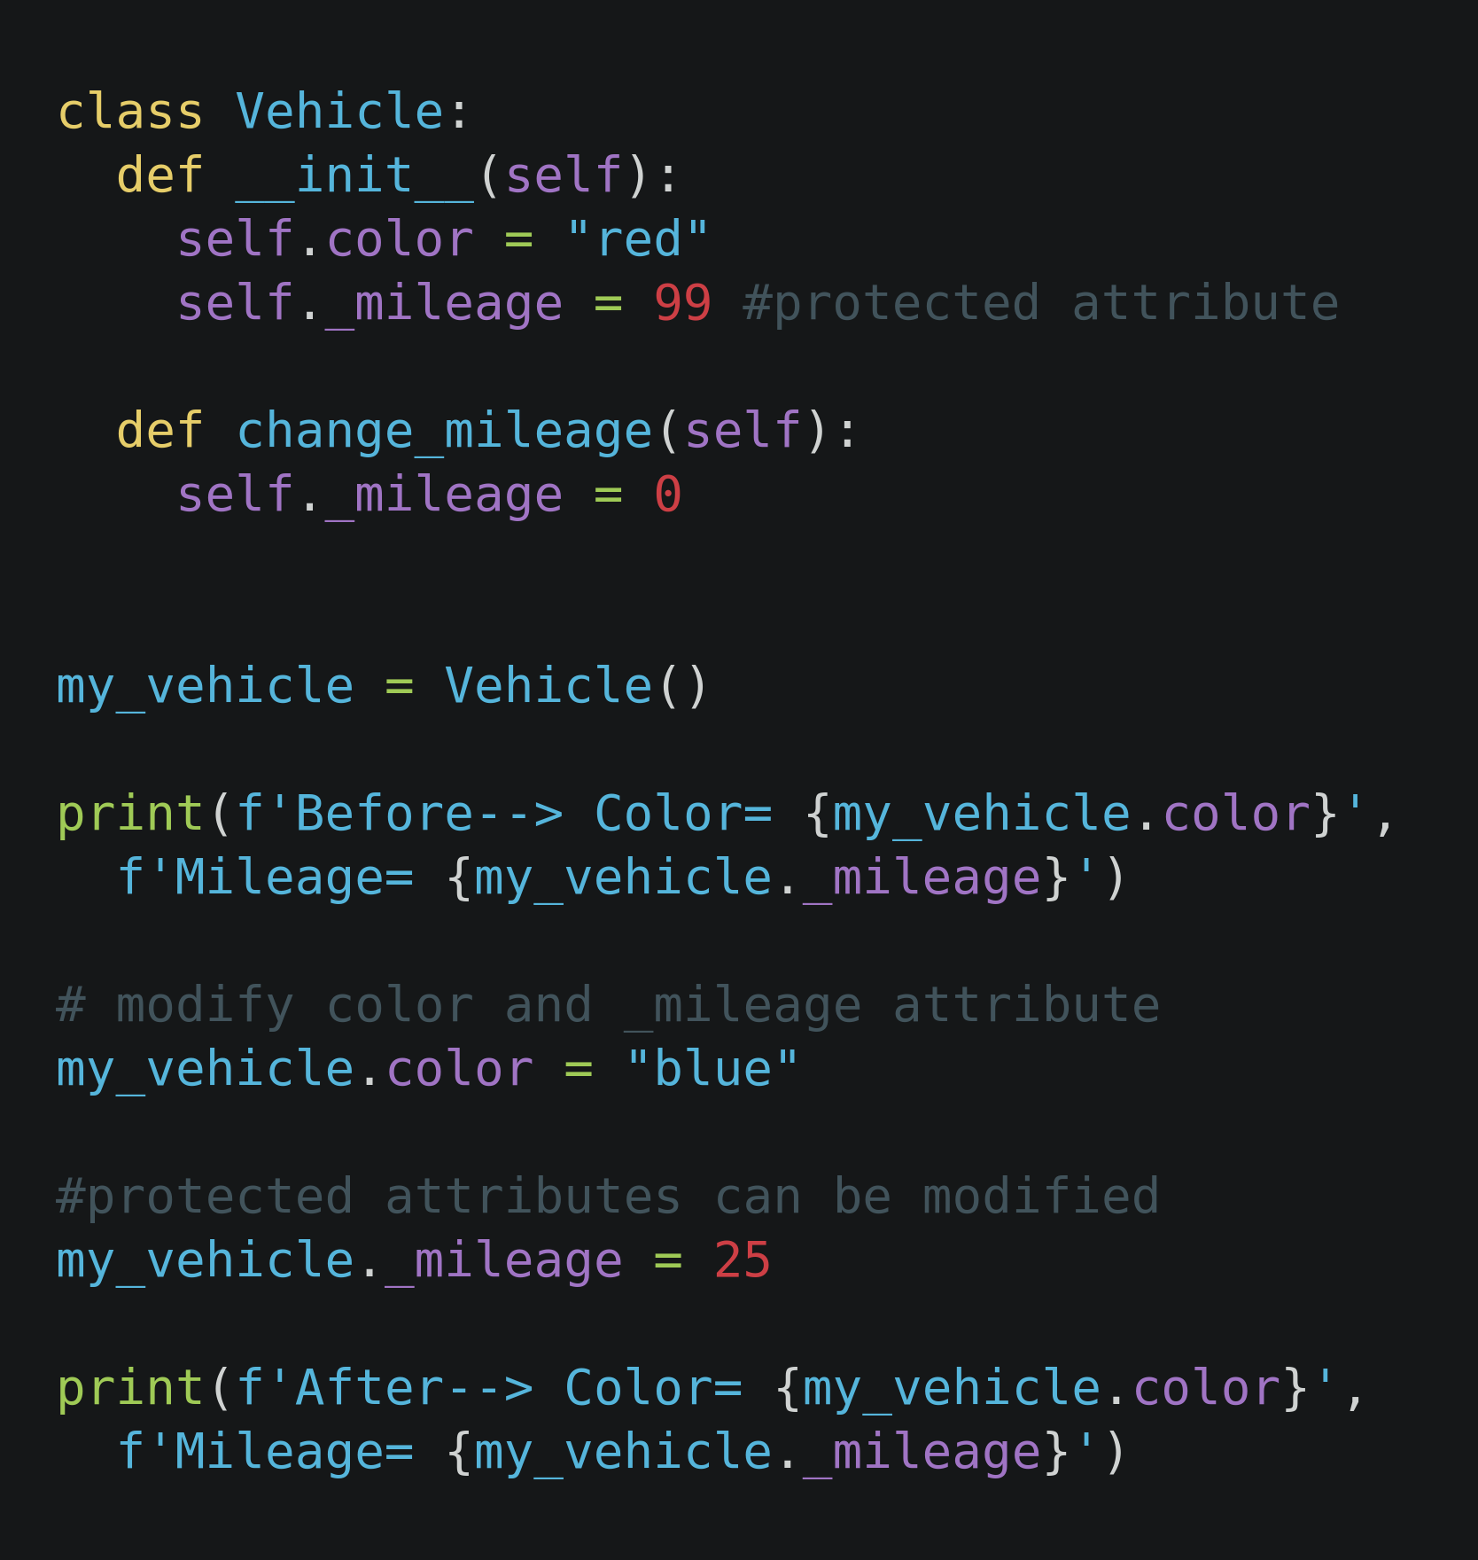
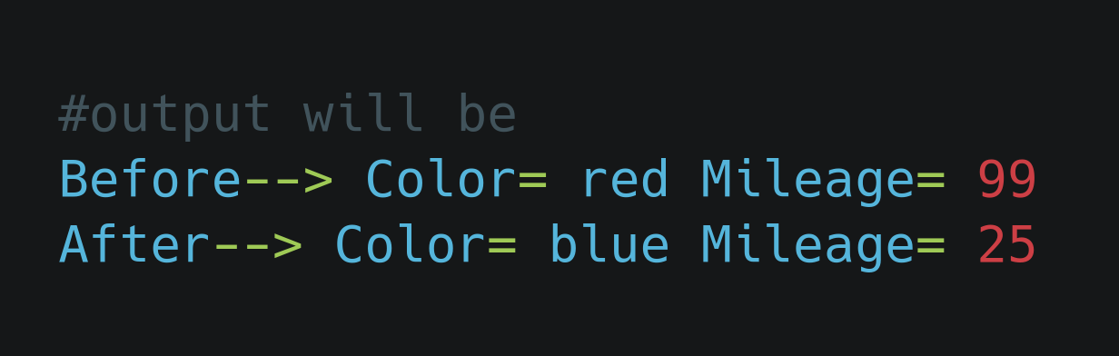
Protected members
Here, we have _mileage as out protected attribute.
Protected members can be modified using instance variables as shown in the code, _mileage has been changed to 25
Hence, a responsible programmer would refrain from accessing and modifying instance variables prefixed with _ from outside its class.

Slide 36
Protected members:
Accessing the protected members like we did in the last slide is anti-pattern.
If you are absolutely sure that you need to access the protected member from the outside, do the following:
Make sure that accessing the member from outside the class does not cause any unintended side effects.
Refactor it such that it becomes part of the public interface of the class.

Slide 37
Private members
Private members are those members of a class that accessible within the class only
But it is not strict in python as they can be accessed from outside the class as well
Private access modifier is the most secure access modifier
Data members of a class are declared private by adding a double underscore ‘__’ symbol before the data member of that class.
It gives a strong suggestion not to touch it from outside the class. Any attempt to do so will result in an AttributeError

Slide 38
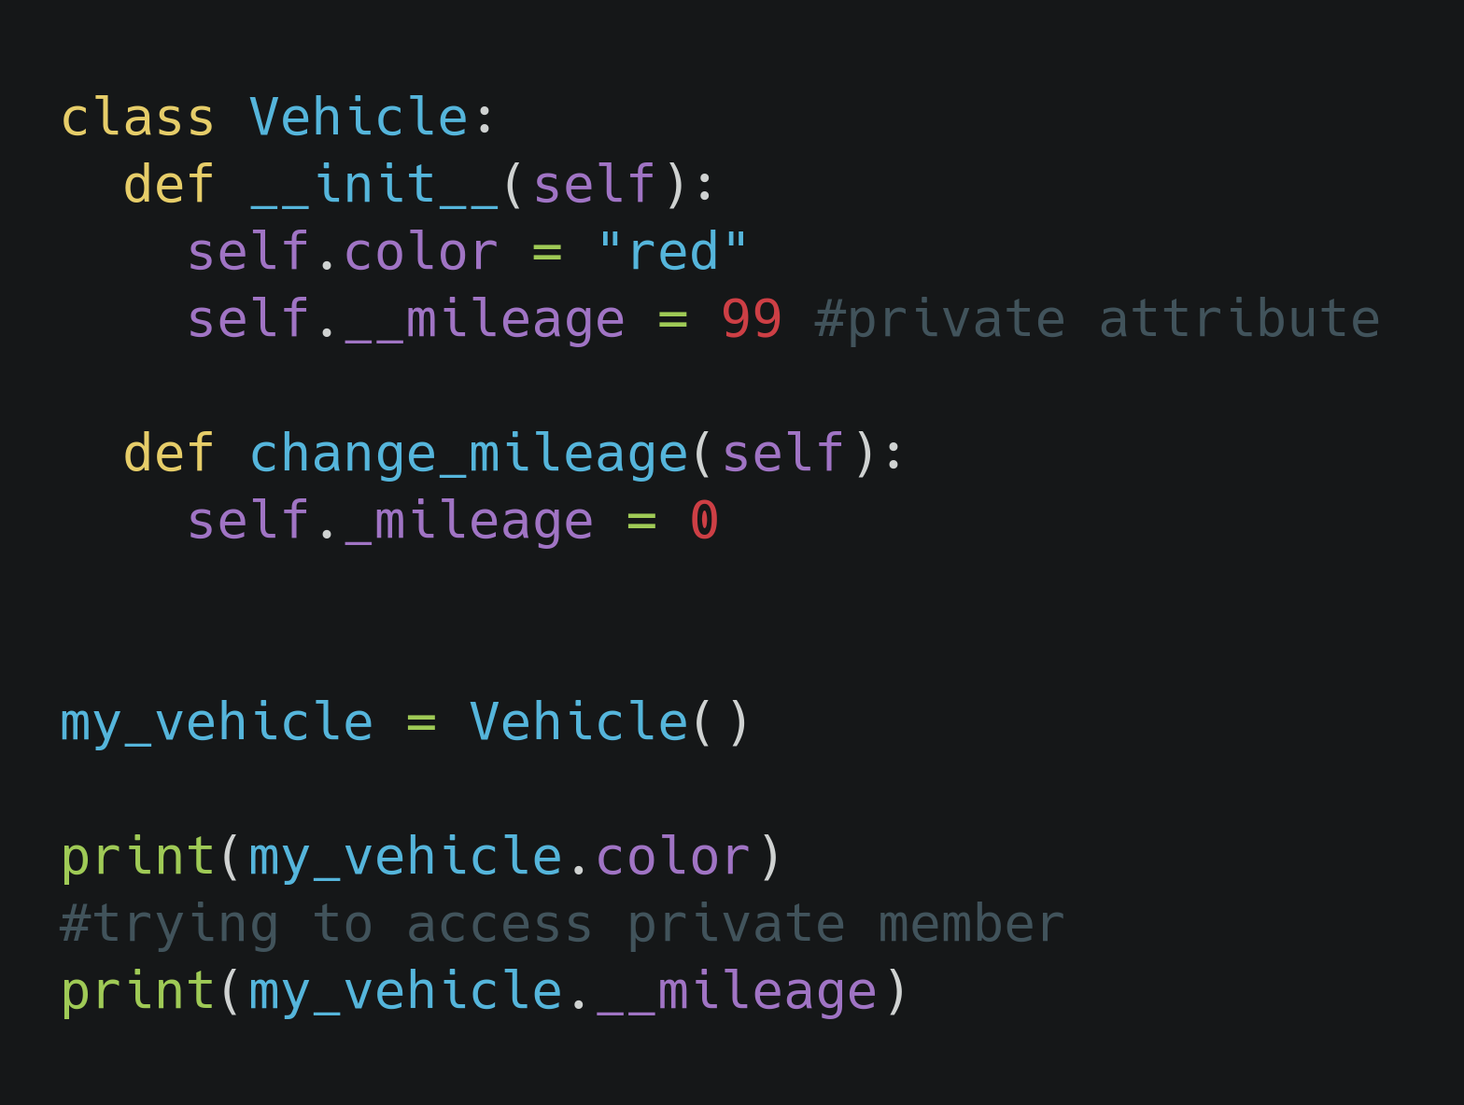
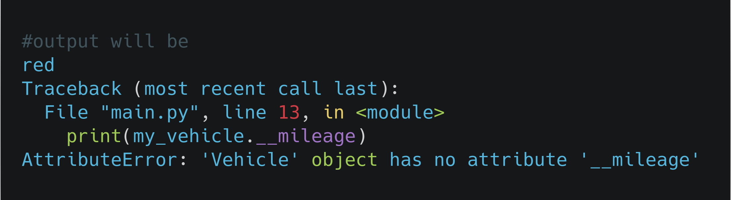
Private members
Here, we have __mileage as out private attribute.
When we tried accessing the private attribute, AttributeError is raised.

Slide 39
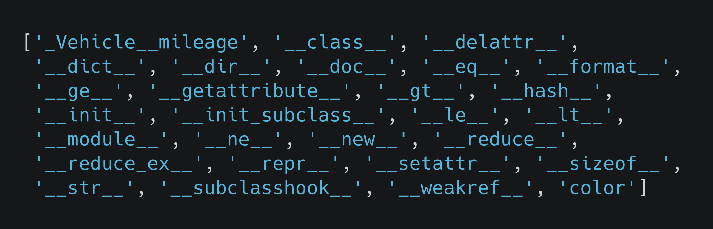


Private members:
so where did our __mileage attribute go?
Let's check the attributes of my_vehicle object
We can see our color attribute.. But where is __mileage?

Slide 40
Name mangling:
If you see closely, you can an attribute named _Vehicle__mileage attribute
That is our __mileage private attribute.
This is called name mangling that the Python interpreter applies. It does this to protect the variable from getting overridden in subclasses.
Python applies name mangling to methods as well

Slide 41
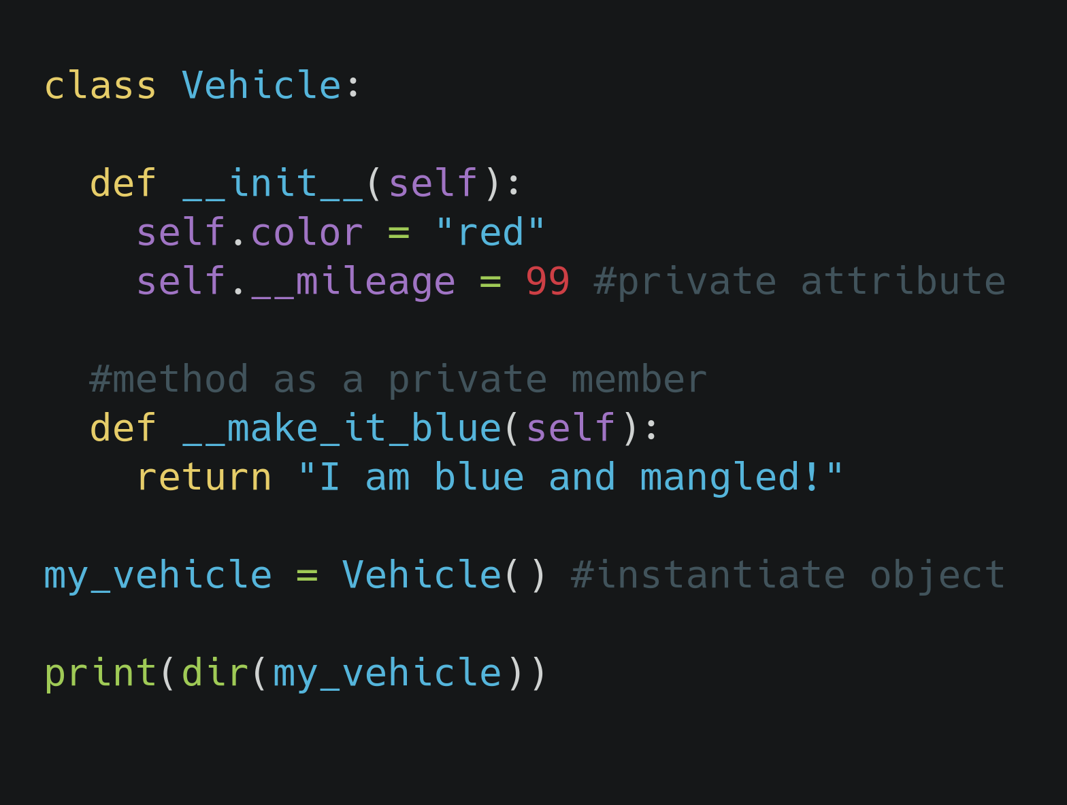
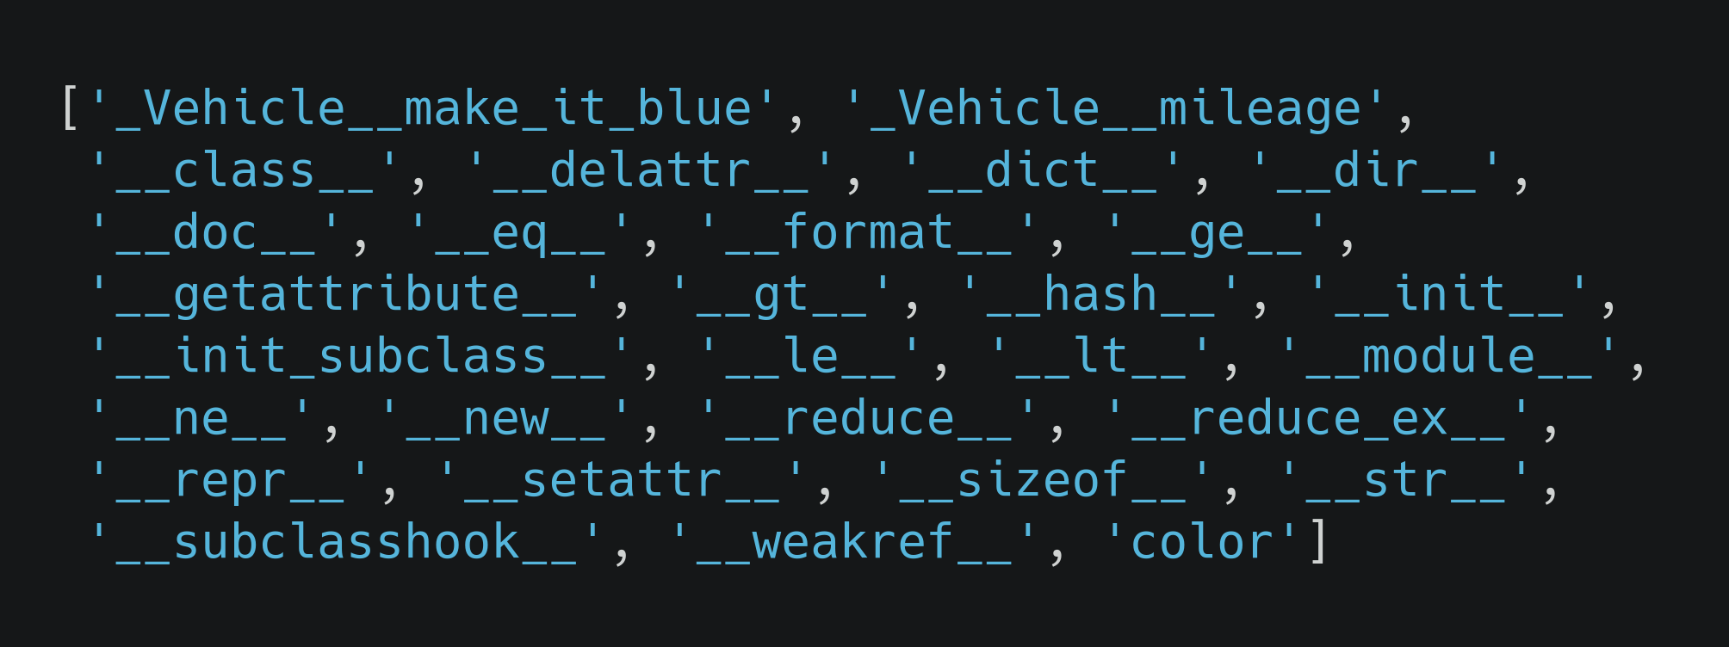
Name mangling example:
Output:

Slide 42
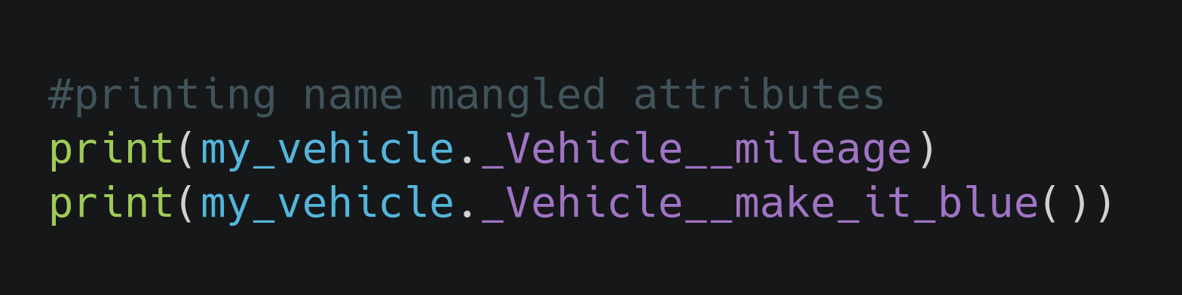
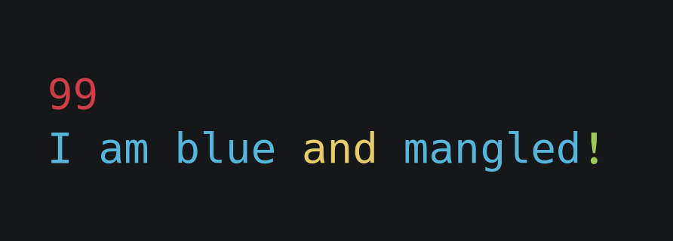
Name mangling
As we see there are two attributes _Vehicle__mileage and _Vehicle__make_it_blue, this is due to name mangling.

Slide 43
Accessing Protected and Private members :
So, now we know unlike many programming languages like Java and C++, private and protected members are a bit different in python.
They can be accessed from outside the class as we have shown it in previous slides
But that is a bad practice and should be refrained.

Slide 44
Python - Magic Methods (Dunder)
Magic methods in Python are the special methods which add "magic" to your class
They have two prefix and suffix underscores in the method name, Dunder here means “Double Under (Underscores)
For example, the object initializer __init__() is a magic method.
You can use dir([object]) to see a list of valid attributes of the object,

Slide 45
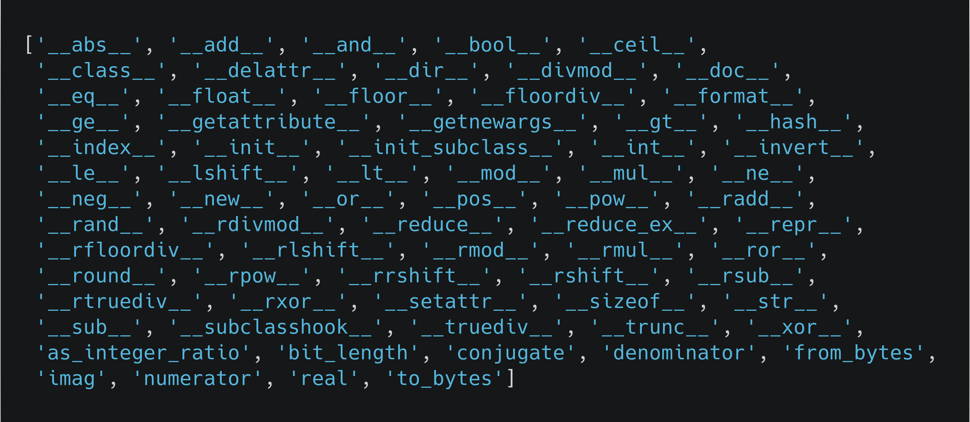
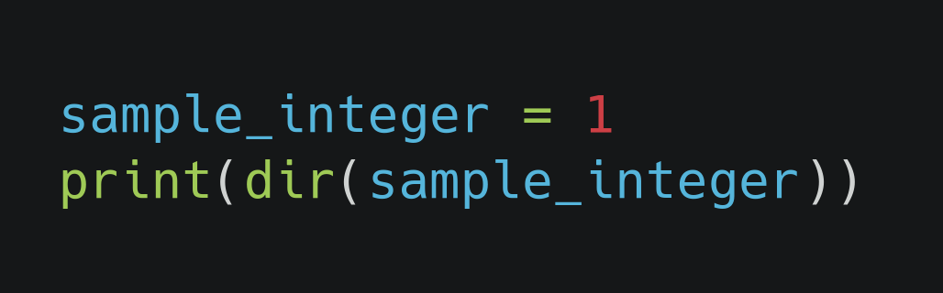
Example:
All the attributes with dunders are magic methods that can be used with the object sample_integer which is just an interger object.

Slide 46
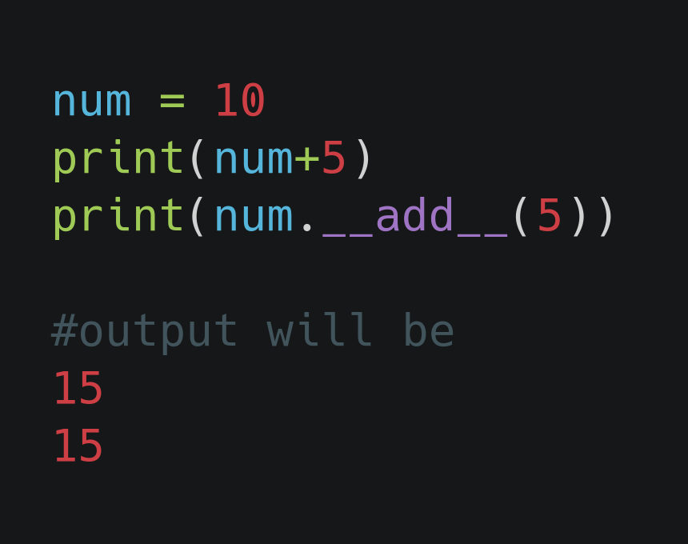
Example:
The __add__ method is a magic method which gets called when we add two numbers using the + operator.
When num + 5 is executed, + operator calls __add__ method, hence the result is same in both cases.

Slide 47
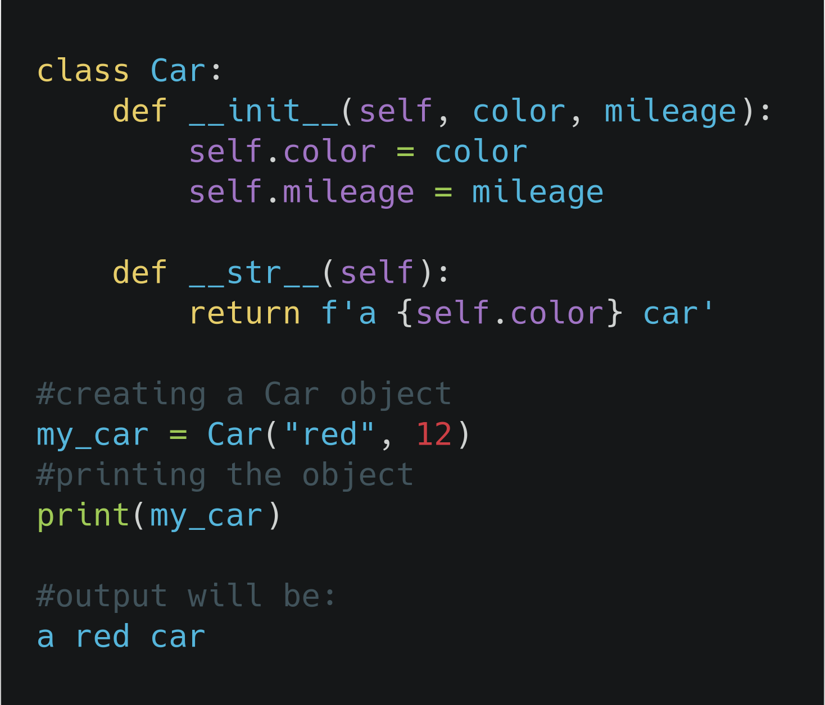
Some Important magic methods
__str__() method:
__str__() is usually overridden to return a printable string representation of any user defined class as shown in the code.
When we printed the object my_car as shown in the example, it prints the string representation of that class

Slide 48
Magic methods list:
Initialization and construction | Description​
__new__(cls, other)​ | To get called in an object's instantiation
__init__(self, other) | To get called by the __new__ method.
__del__(self) | Destructor method.​
Attribute Magic Methods | Description​
__getattr__(self, name) | Is called when the accessing attribute of a class
__setattr__(self, name, value) | Is called when assigning a value to the attribute of a class
__delattr__(self, name | Is called when deleting an attribute of a class.

Slide 49
Magic Methods:
There are a lot of magic methods that you can use and customize, for more on this you can follow Python's official doc about special method names:
https://docs.python.org/3/reference/datamodel.html#special-method-names

Slide 50


